Slide 1


Answers to Open-Ended Questions
Candidat : Hervé ALIA

Slide 2
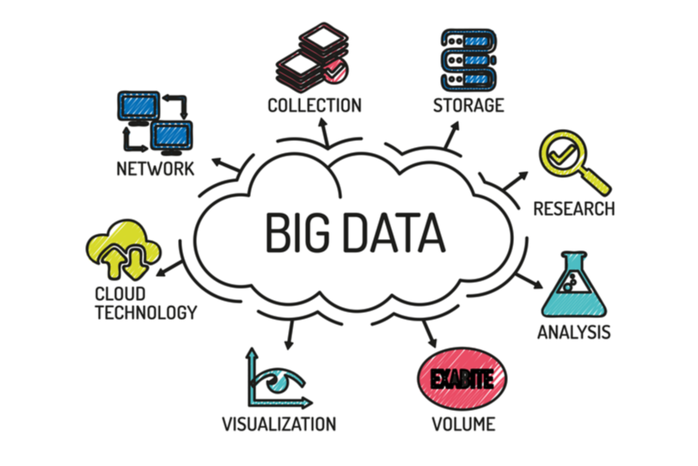

Slide 3
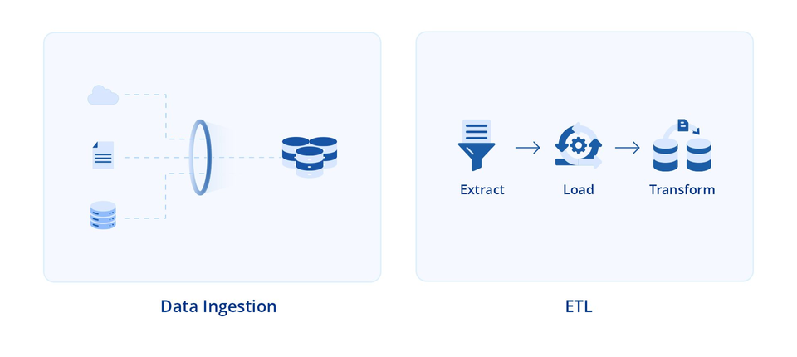
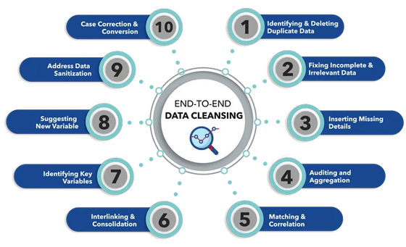
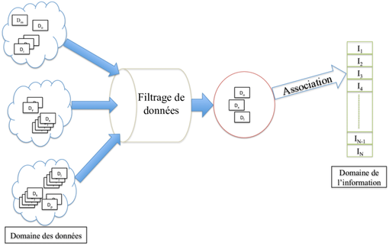
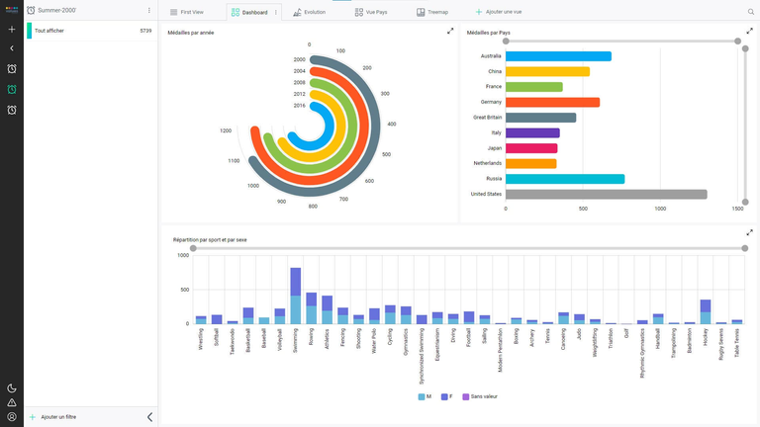
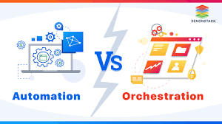


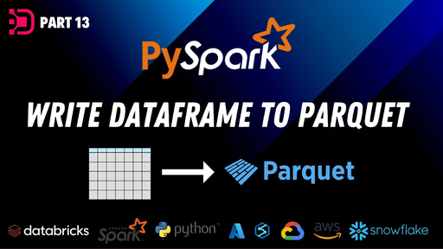
I- Managing Data Transformations for Large Volumes
A- Data Ingestion
B-Data Cleaning
C- Data Transformation
E- Data Visualization and Analysis
F- Automation and Orchestration
D- Data Storage

Slide 4
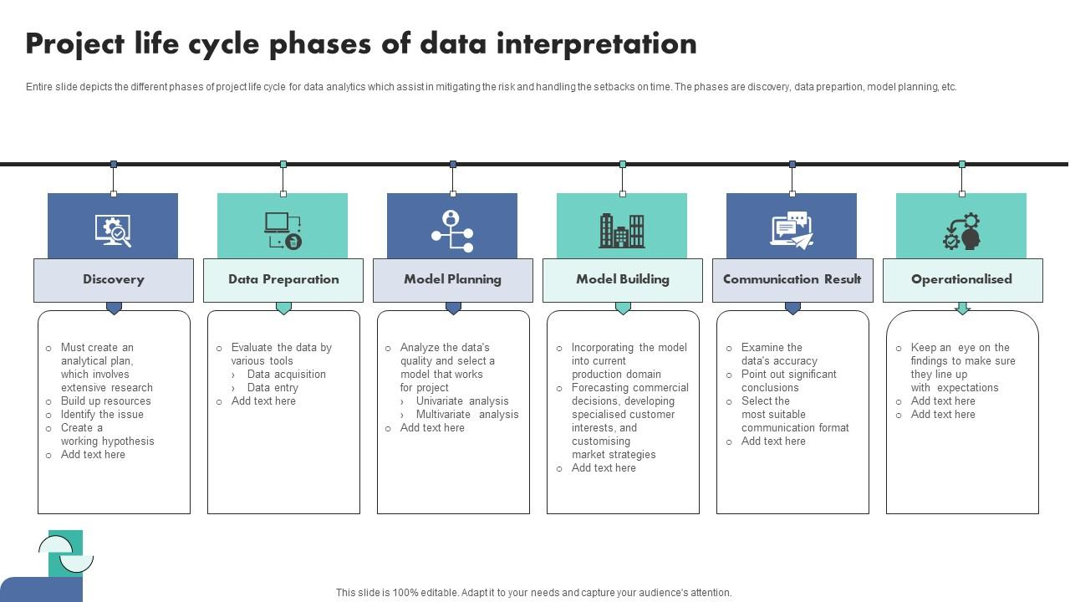
II -The Different Steps of a Data Project

Slide 5

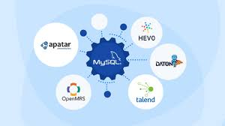
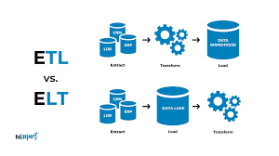
III- Tools for Real-World Enterprise Use Cases

Slide 6
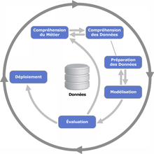
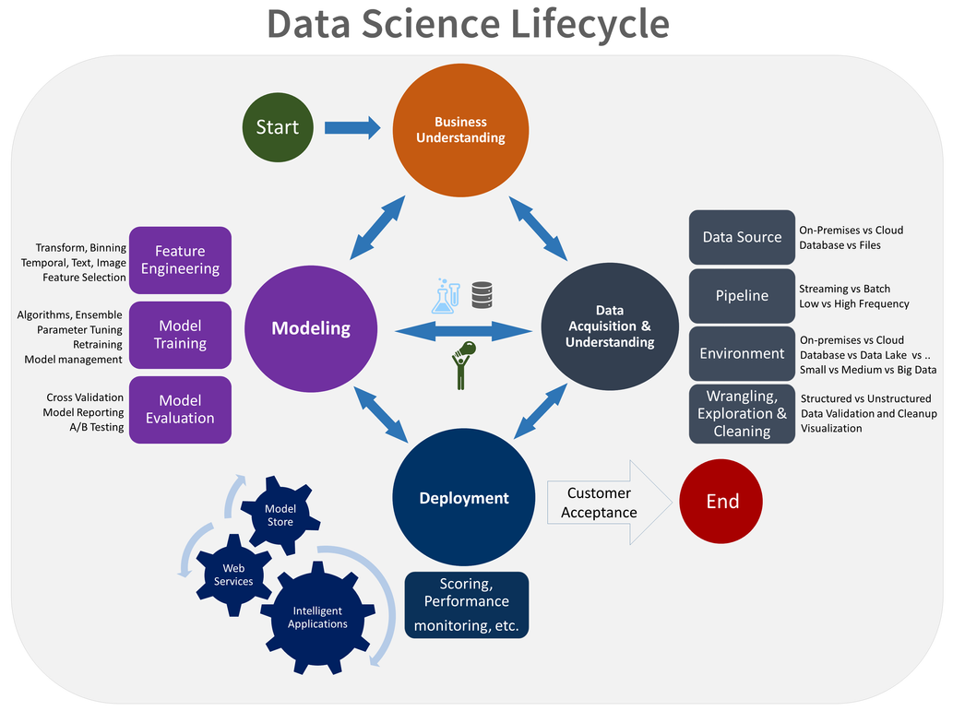
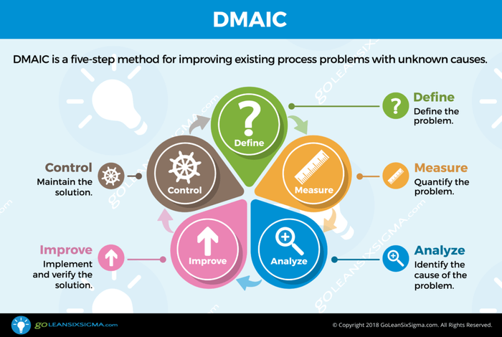
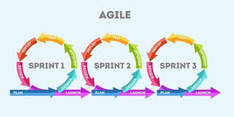
IV- The Work Methodology Adapted to a Data Project
1. CRISP-DM (Cross-Industry Standard Process for Data Mining)
3. Team Data Science Process (TDSP)
4. Lean Six Sigma
2. Agile

Slide 7
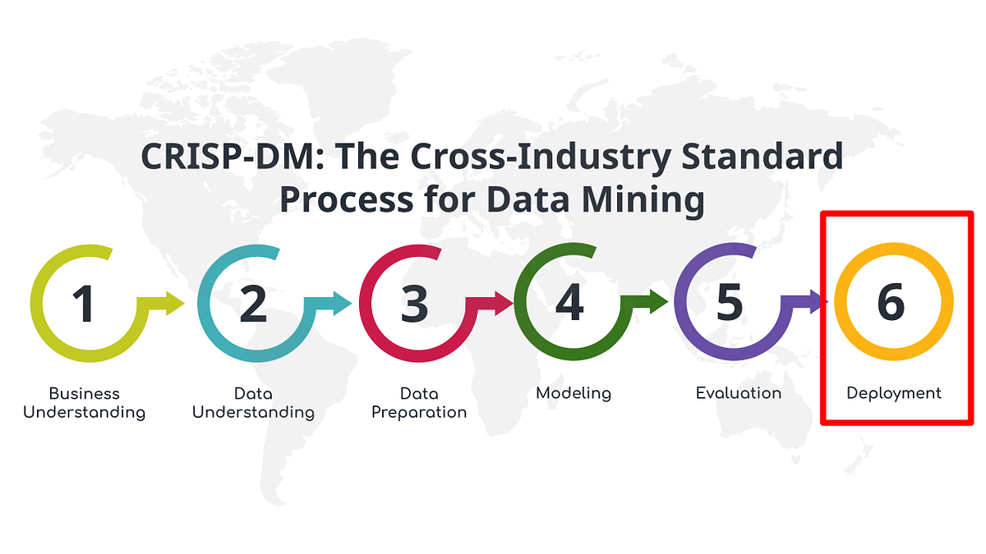
For data projects in the healthcare domain, I believe CRISP-DM (Cross-Industry Standard Process for Data Mining) would be a suitable methodology.
Its flexibility, clear structure, and tool-agnostic nature make it an excellent choice for data science projects.

Slide 8
Thank you for your attention!

